Slide 1
Data Structures
ICT-1211
Information and Communication Technology
Lecture-01
Date:

Slide 2
Introduction

Slide 3
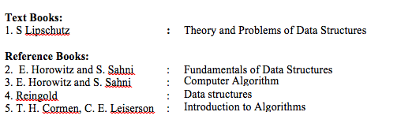
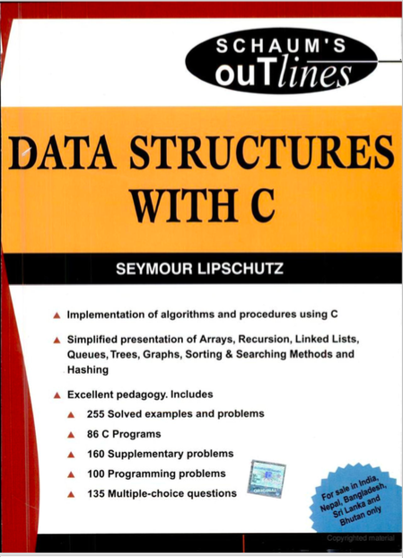

Slide 4
?
Data are simple values or set of values.
Data item refers to a single unit of values.
Data items that are divided into sub-items are called group items.
For example:
An employee’s name may be divided into three sub item…..
First name
Middle name
Last Name.
But, NID number would be normally be treated as a single item

Slide 5
Collection of data are frequently organized into a
    Hierarchy of fields
    Records
    Files
Entity?
An entity is something that has certain ATTRIBUTE or PROPERTIES which may be assigned VALUES.
may be numeric or non-numeric
ATTRIBUTE | NAME | Age | Sex | Height | NID
Values | Jhon | 30 | Male | 65 cm | 27642847

Slide 6
Entity Set?
Entities with similar ATTRIBUTES form entity set.
Example:
  All the employee in an organization
  All the students of any department.
Each attribute of an entity set has a range of values

Slide 7
Information?
Processor
Data
Information
Processed dare are usually called information.

Slide 8
Data Structure?
Data may be organized in many different ways.
The logical or mathematical model of a particular organization of data is called a data structure
Particular data model depends on TWO consideration:
  It must be rich enough in structure to mirror the actual relationships of the data in real world.
  The structure should be simple enough that can be efficiently process the data when necessary.
Notes:
Logical data structures are data models, and are sometimes called entity-relationship (ER) models or even entity-attribute-relationship models. Databases mirror aspects of the real world. ... Logical data structures are models which look both ways - at the real world and at the database world.

Slide 9
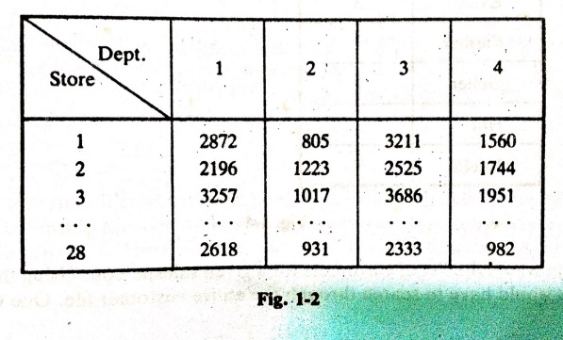
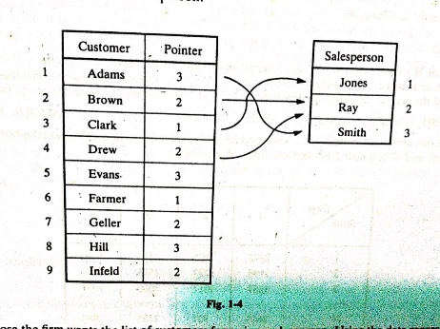
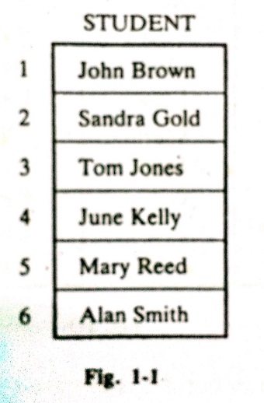
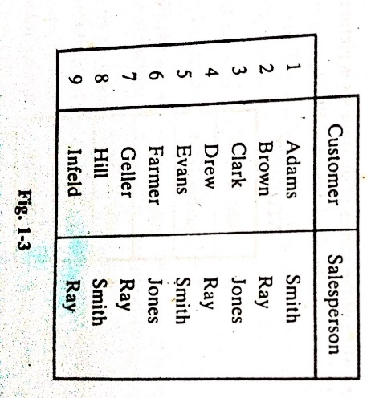
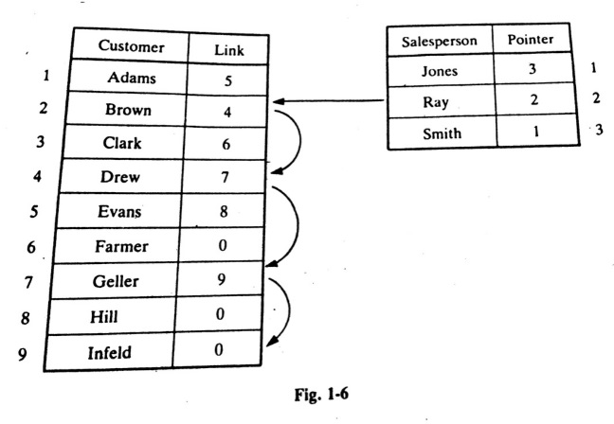
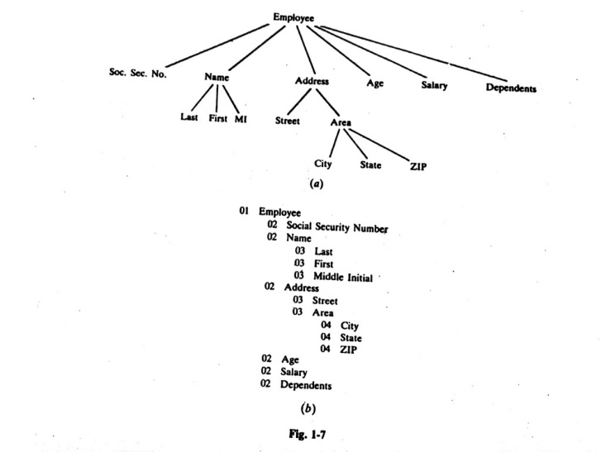
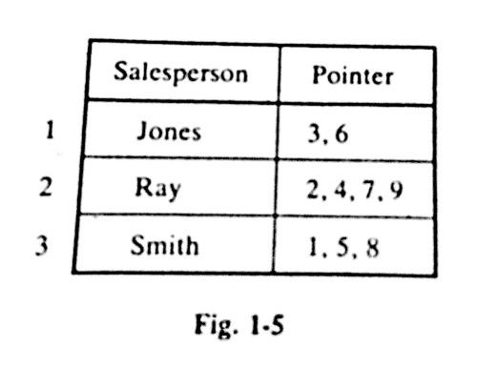
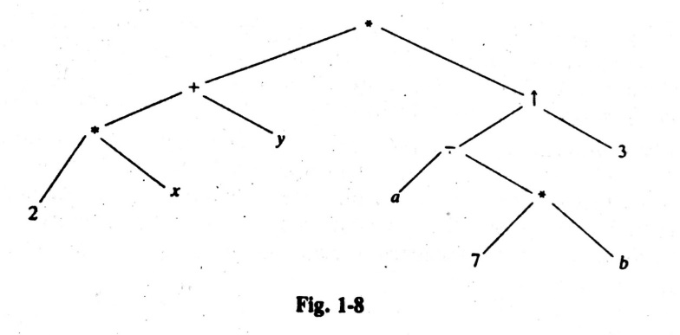
Some Data Structure
Two D array
Linked List
One D array
(2x+y)(a-7b)³
Hierarchical

Slide 10


Data Structure: Array
Simplest types of data structure
One dimensional array /Linear
Two dimensional Array

Slide 11
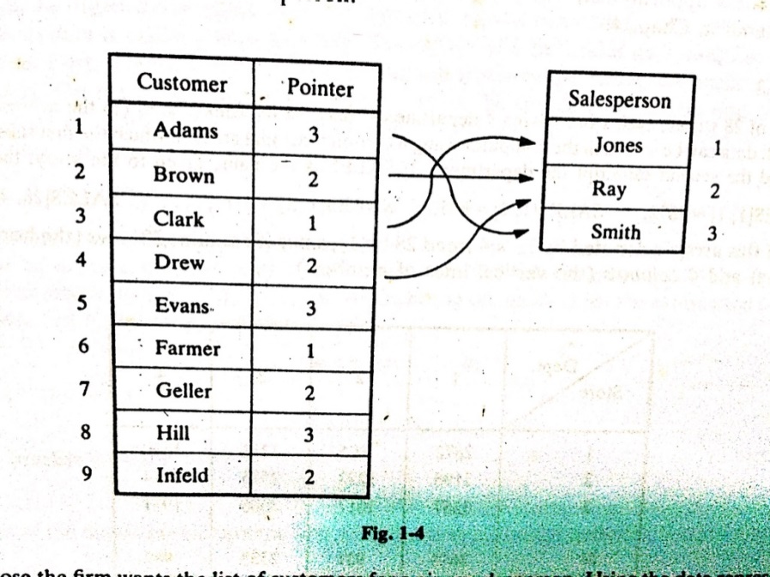


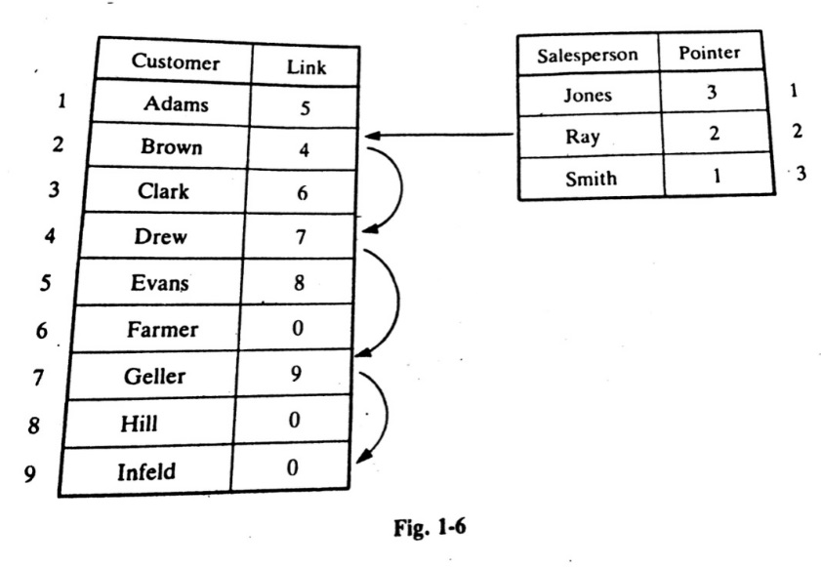
Data Structure: Link List
Advantages: An integer used as a pointer requires less space than a name. Hence this representation saves spaces, if there are hundreds of customers for each salesman

Slide 12


Data Structure: Tree
Data frequently contain a hierarchical relationship between various elements. The data structure reflects this relationship is called a rooted tree graph or simply a tree

Slide 13
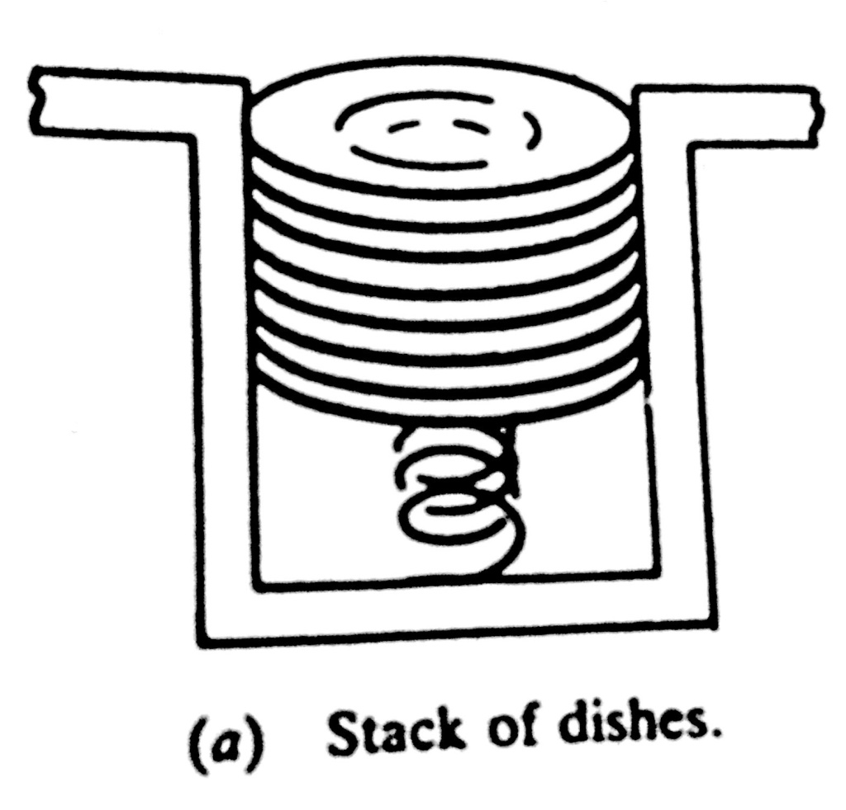
Data Structure: Stack
LIFO

Slide 14
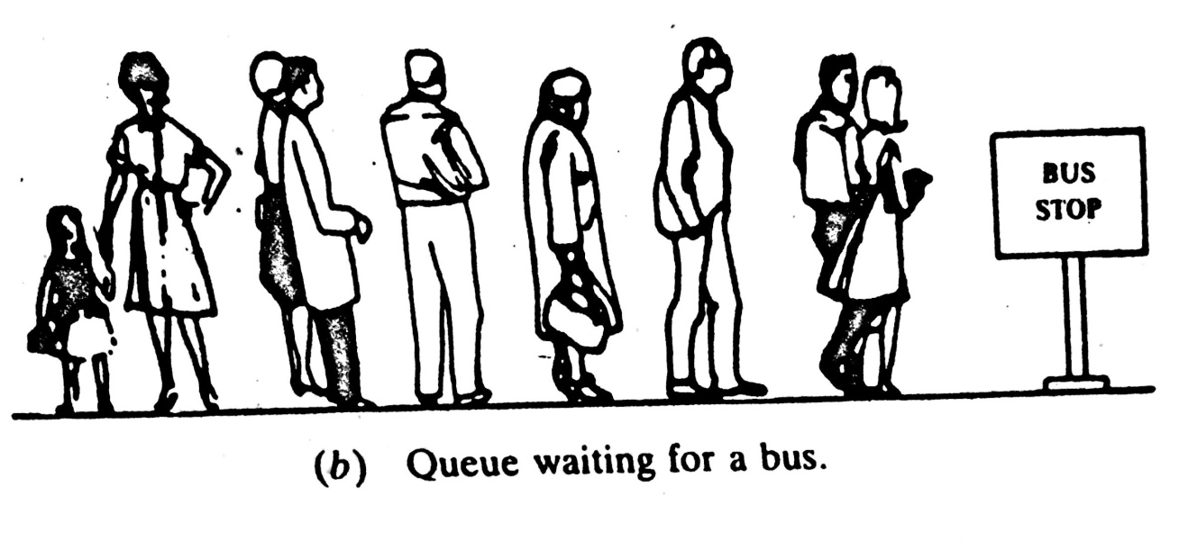
Data Structure: Queue
FIFO

Slide 15
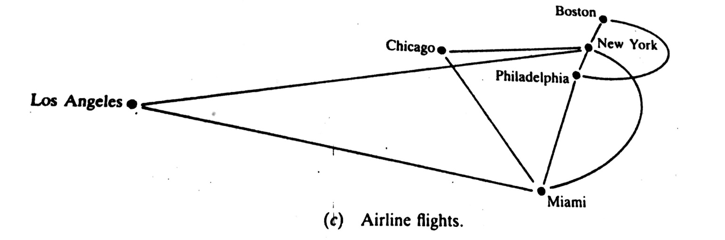
Data Structure: Graph

Slide 16
Thank you……

